Slide 1
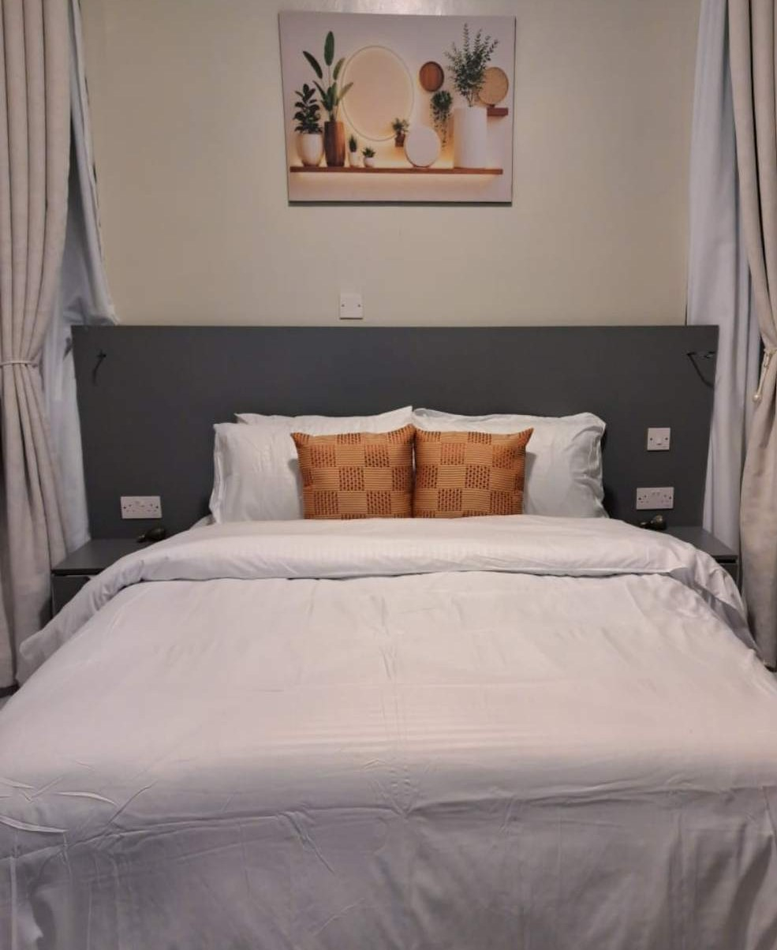
A booking website and admin panel
KILIMANJARO HOTELS · SOTIK
Guests check availability and send booking requests. Staff run bookings, rooms and prices from one place.
November 2026
Notes:
This deck walks through the new online booking system for Kilimanjaro Hotels in Sotik: the website guests use, the admin panel staff use, and how it runs behind the scenes. Every screenshot is from the real system. The admin screenshots use made-up sample guests.

Slide 2


Two parts, one system
Website, for guests
Admin panel, for staff
Rooms, photos and prices
Availability for any dates
Booking request, then WhatsApp
Today's arrivals and requests
Confirm bookings, take payments
Edit rooms, prices and content
24/7
KES 2,500
KES 0
1 min
booking requests, day and night
a night, the starting room rate
a month to host (free plans)
for a guest to send a request
Notes:
The system has two parts. Guests use the website to look at rooms, check dates and send a booking request. Staff use the admin panel to answer requests, confirm bookings, take payments and keep the website up to date. Rooms start from 2,500 shillings a night, and hosting is free on the current plans.

Slide 3
The hotel
01
Comfortable, good-value rooms in Sotik, Bomet County, a short drive from the tea country.
Notes:
First, the hotel itself: where it is, the rooms, what every stay includes, and how guests reach us.

Slide 4
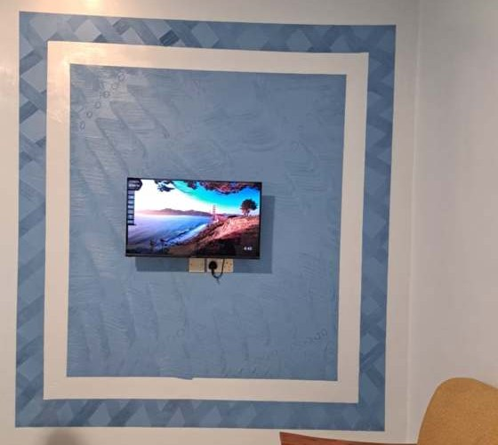
Welcome to Kilimanjaro Hotels
A comfortable, good-value place to stay in Sotik, Bomet County, for guests on business, visiting family or passing through the tea country.
Freshly made beds, hot showers, a restaurant serving meals throughout the day, and a team that’s happy to help. Meeting and event space too.
CHECK-IN FROM
CHECK-OUT BY
RECEPTION
2:00 PM
10:00 AM
24 hours
Notes:
Kilimanjaro Hotels welcomes guests looking for a comfortable, good-value stay in Sotik, Bomet County: business travellers, families visiting relatives and people passing through the tea country. Check-in is from 2 PM, check-out by 10 AM, and reception is open around the clock.

Slide 5
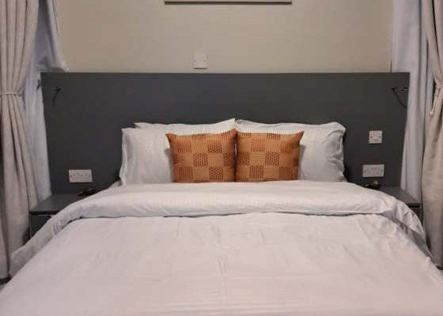
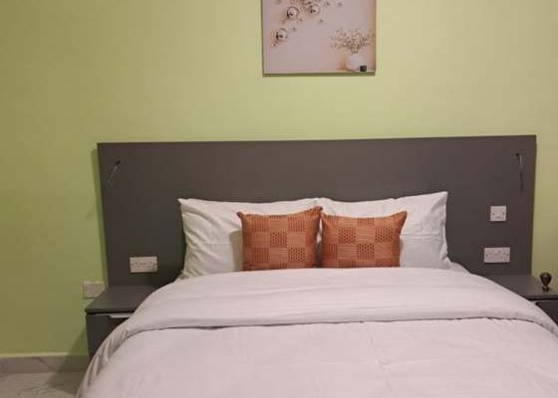
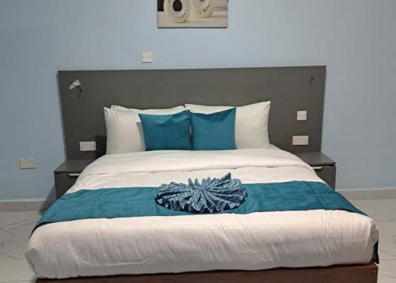

Our rooms
Photo coming soon
Sand Room
Sage Room
Teal Room
New rooms
KES 3,000 a night
KES 3,000 a night
KES 3,000 a night
KES 2,500 a night
Warm cream walls, full-length curtains and copper cushions.
Fresh green walls and a calm, bright feel.
Sky-blue walls, teal bedding and tiled floors.
Just opened. Ask at reception to see the room.
Double bed · up to 2 guests
Double bed · up to 2 guests
Double bed · up to 2 guests
Double bed · up to 2 guests
Notes:
Three rooms at 3,000 shillings a night, each with its own colour scheme: Sand, Sage and Teal. A new set of rooms at 2,500 shillings has just opened; their photos are still to come, so guests are invited to see them at reception. Every room has a double bed and sleeps up to two.

Slide 6






Every stay includes
Free Wi‑Fi
Restaurant and bar
Secure parking
Fast enough for video calls.
Breakfast, lunch and dinner daily.
Guarded and free for guests.
Hot showers
Conference space
24-hour reception
Reliable hot water in every room.
Meetings, weddings and events.
Check in any time of day.
Notes:
Every stay includes free Wi-Fi, secure guarded parking and hot showers, with a restaurant and bar serving breakfast, lunch and dinner. There is conference space for meetings, weddings and events, and reception is open 24 hours.

Slide 7
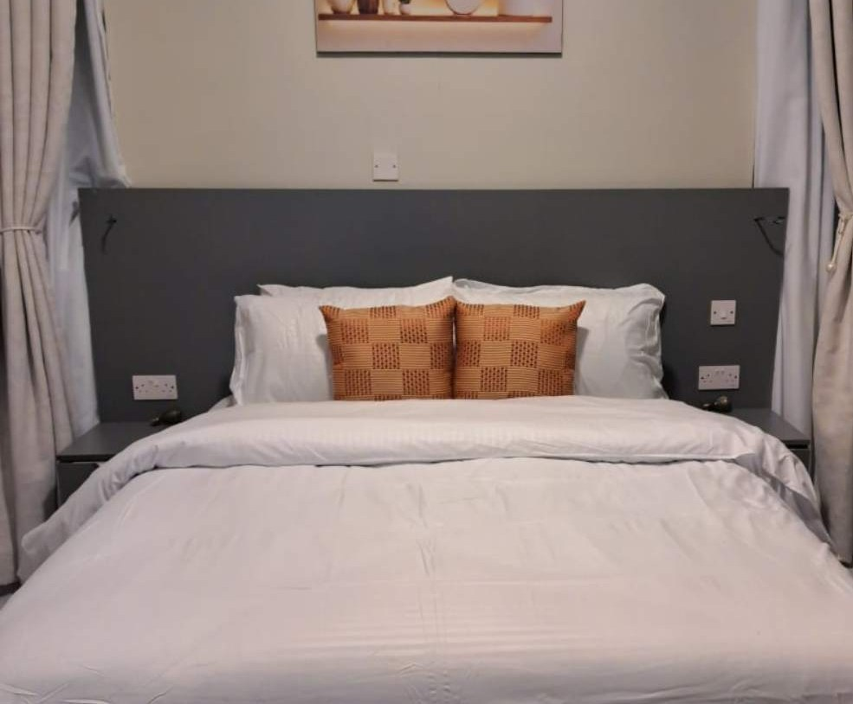
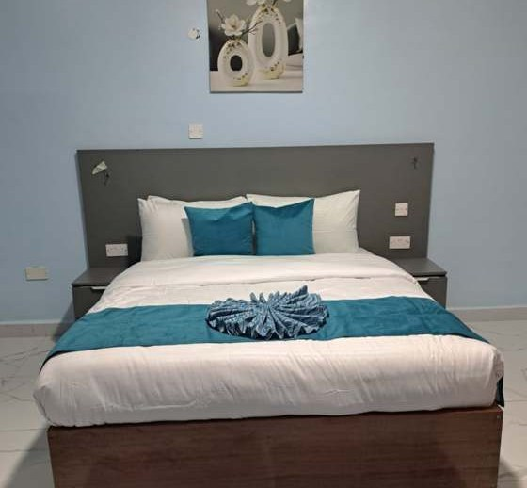
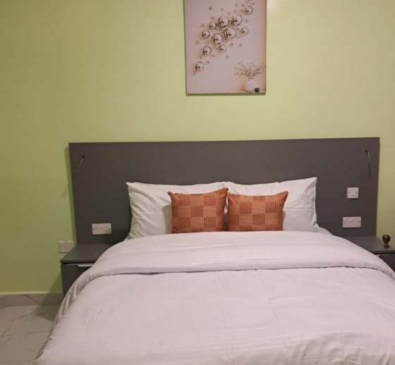
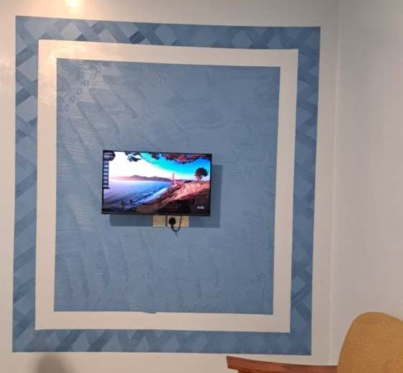
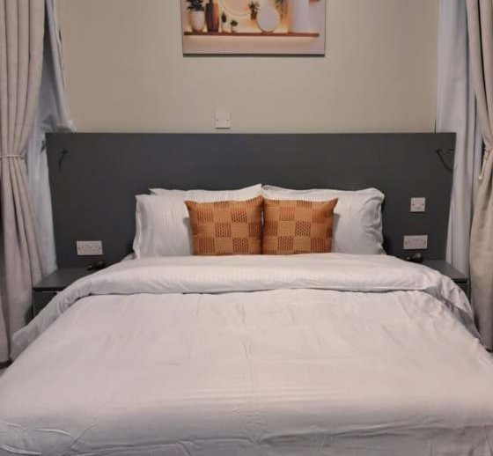
A look inside
Teal Room
Sage Room
Sitting area
Sand Room
Notes:
A look inside the hotel: the Sand, Teal and Sage rooms and the guest sitting area. The same photos appear on the website gallery, and staff can add more from the admin panel.

Slide 8




Visit, call or book
Sotik, Bomet County, Kenya
CHECK-IN
Street address and map pin coming soon.
From 2:00 PM
+254 700 262 745
CHECK-OUT
Call or WhatsApp the front desk.
By 10:00 AM
info@kilimanjarohotelssotik.co.ke
WAYS TO PAY
For group bookings and events.
Pay at the hotel
M-Pesa on arrival
Book online any time
Card on arrival
hillarymutaik.github.io/kilimanjaro-hotels-sotik
Notes:
Guests can find us in Sotik, Bomet County; the exact street address and map pin will be added soon. Call or WhatsApp the front desk on +254 700 262 745, email for group bookings and events, or book online any time. Check-in is from 2 PM and check-out by 10 AM. Guests pay at the hotel, by M-Pesa or by card on arrival.

Slide 9
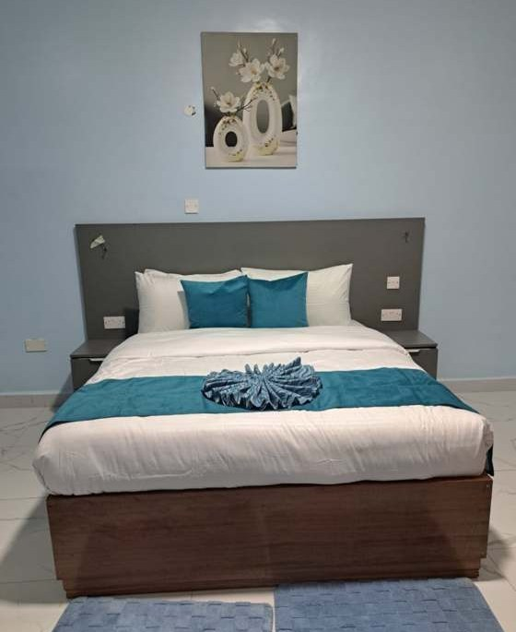
The guest website
02
What a guest sees, from the first visit to a booking request.
Notes:
First, the website: what a guest sees from the moment they land to the moment they send a booking request.

Slide 10
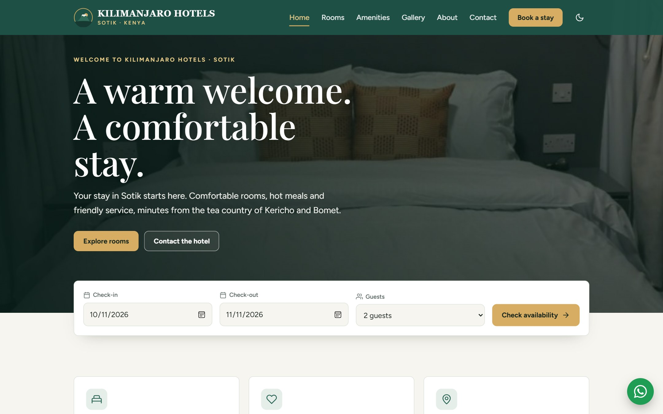



A home page that invites booking
Sells the stay
Real room photos, warm words and clear prices.
Dates on screen one
Check-in, check-out and guests, right away.
One tap to the desk
A WhatsApp button on every page.
Notes:
The home page opens with a real photo of the Sand Room and the date search straight away, so a guest can check availability without hunting for it. The green WhatsApp button stays on screen on every page.

Slide 11
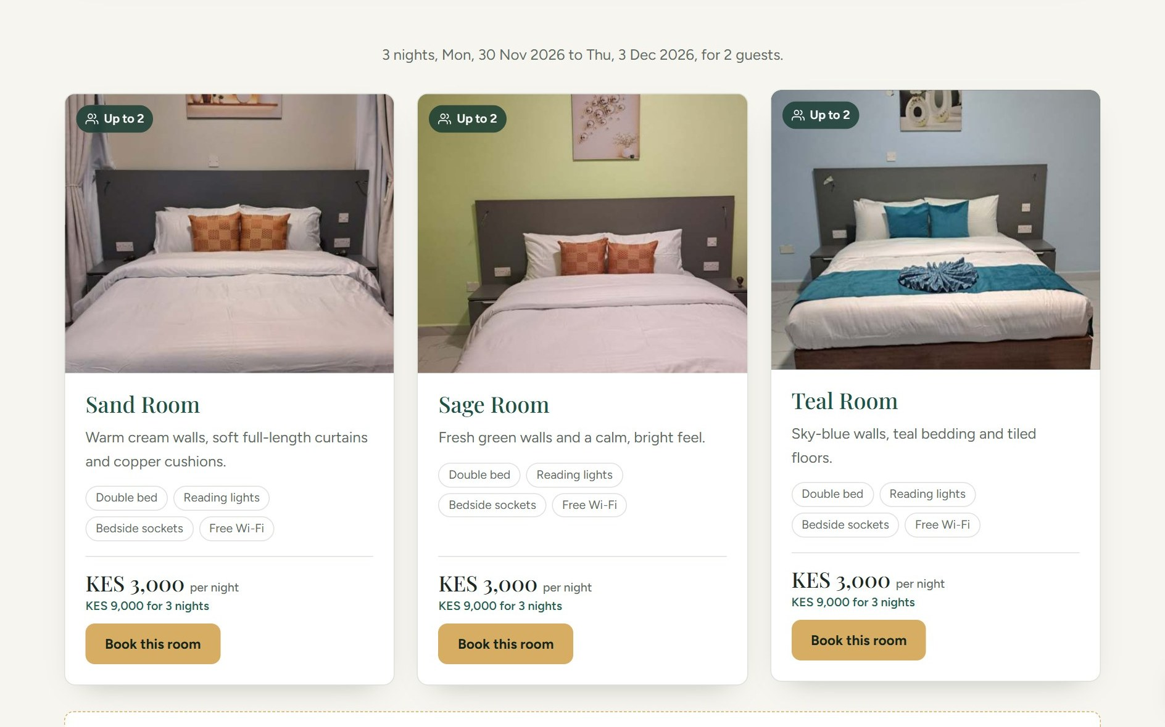



Live availability and prices
Pick dates once
The search carries across every page.
The full price
Per night, and the total for the stay.
Only free rooms
Taken dates come from the live bookings.
Notes:
After a guest picks dates, every room shows the price per night and the total for the stay, here 9,000 shillings for three nights. Rooms that are already confirmed for those dates are marked as unavailable, using the live booking data.

Slide 12
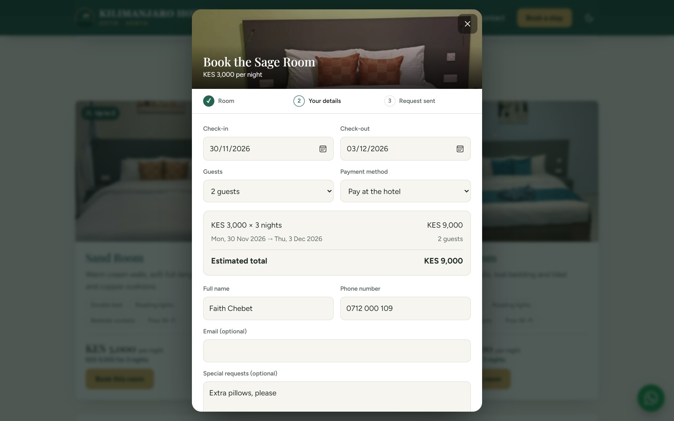
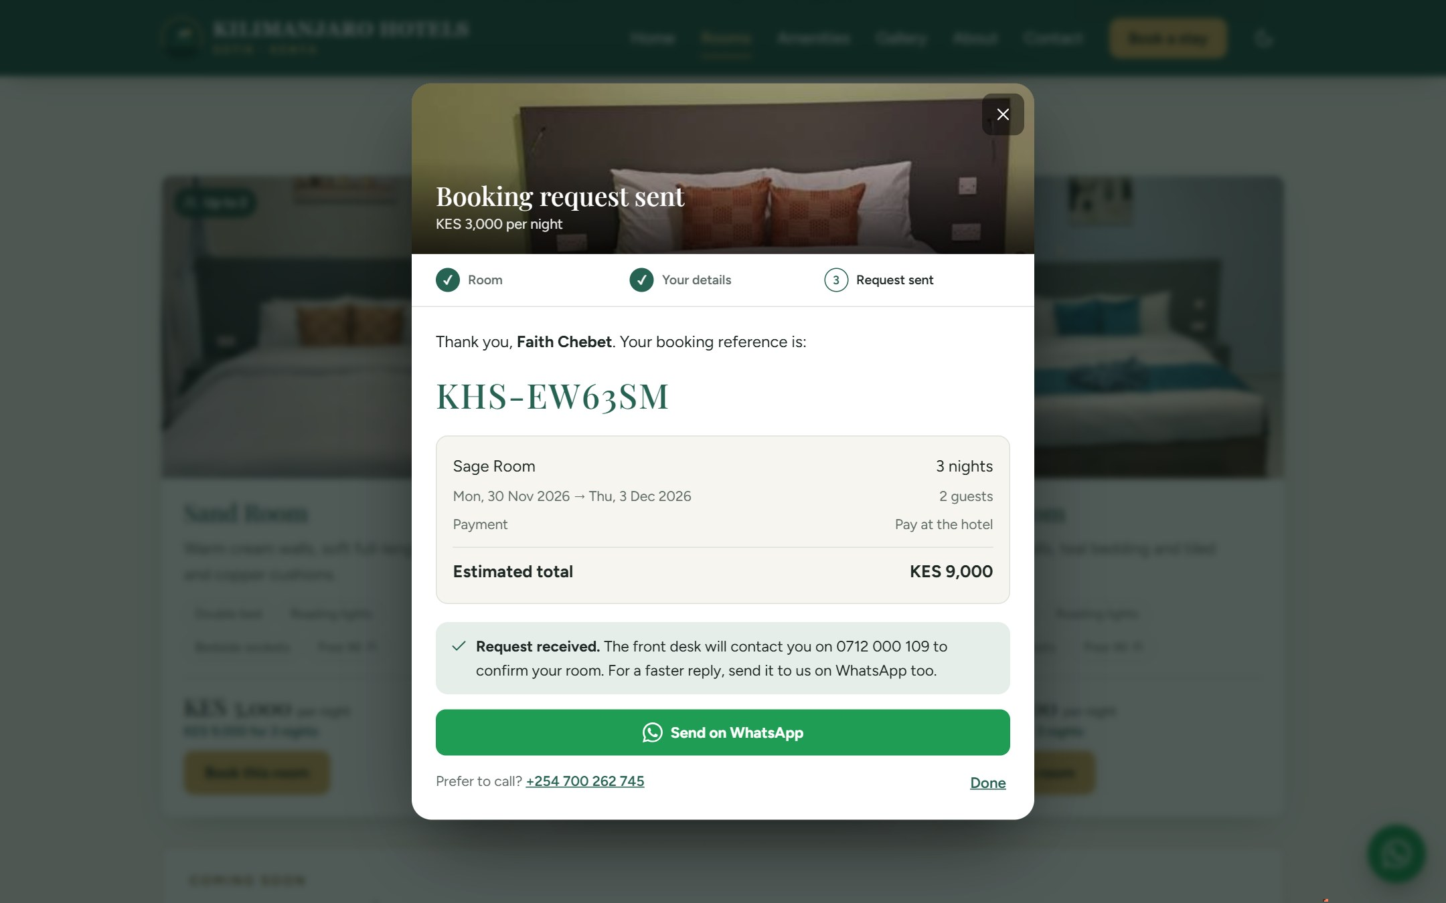
Booking in two steps
1
Dates, guests, name and phone
2
A booking reference, then WhatsApp
Notes:
Booking takes two steps. The guest fills in dates, number of guests, name and phone, and sees the estimated total. After sending, they get a booking reference and a button to send the same details on WhatsApp. The request reaches the admin panel as Pending, for staff to confirm.

Slide 13
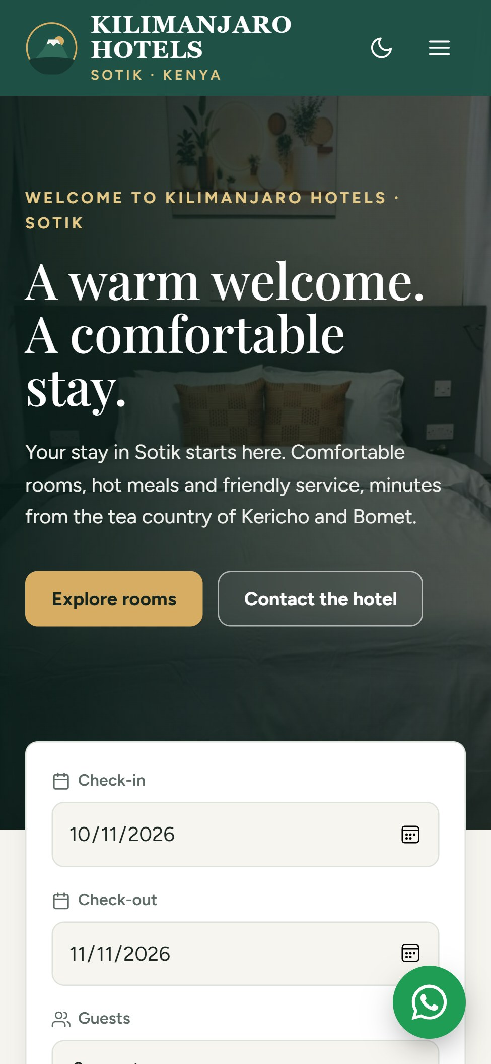
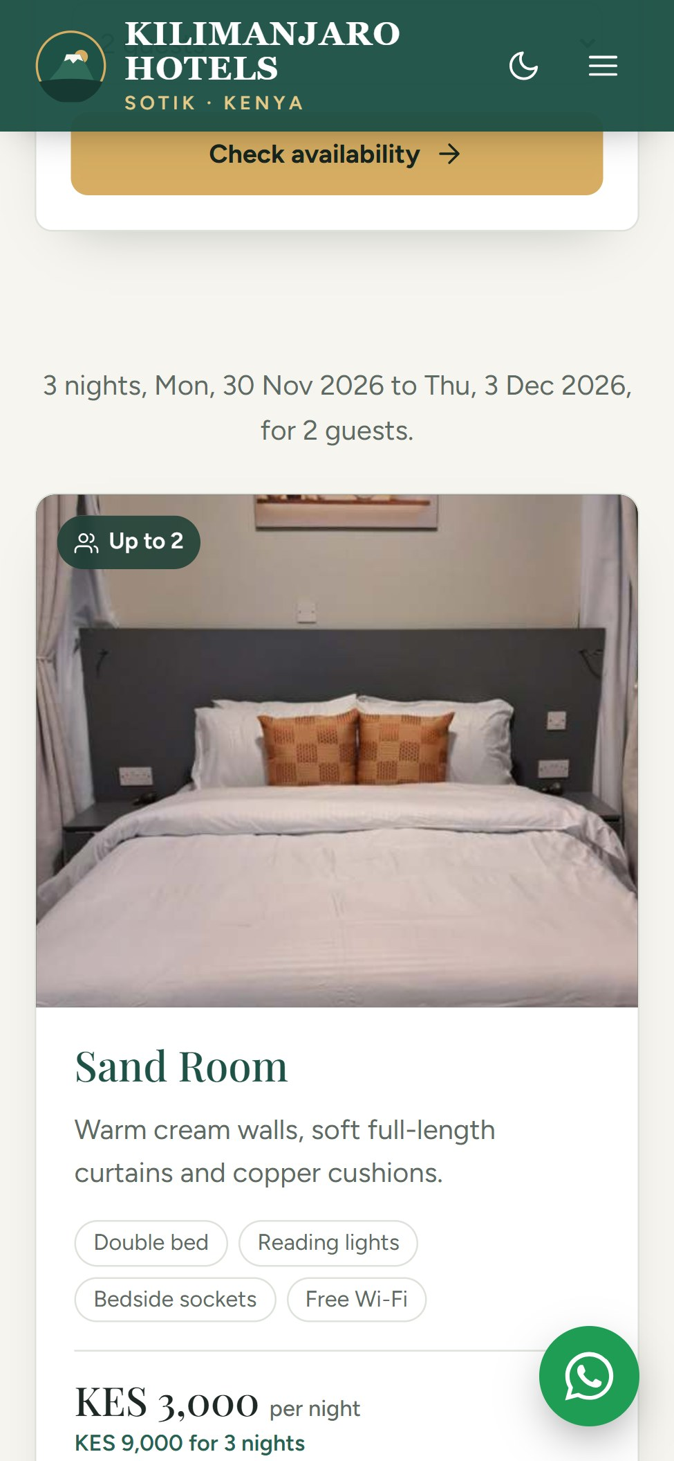


Made for phones
Every page works on a phone, with big buttons, easy-to-read text and the hotel a tap away.
Thumb-friendly
Menus and buttons sized for touch.
Call or WhatsApp
Straight from the page, no copying numbers.
Light and dark mode
Guests can switch to suit their screen.
Notes:
Many guests will find the hotel on their phone, so every page is laid out for small screens: the menu folds away, buttons are large, and calling or WhatsApping the hotel is one tap. Guests can also switch between light and dark mode.

Slide 14
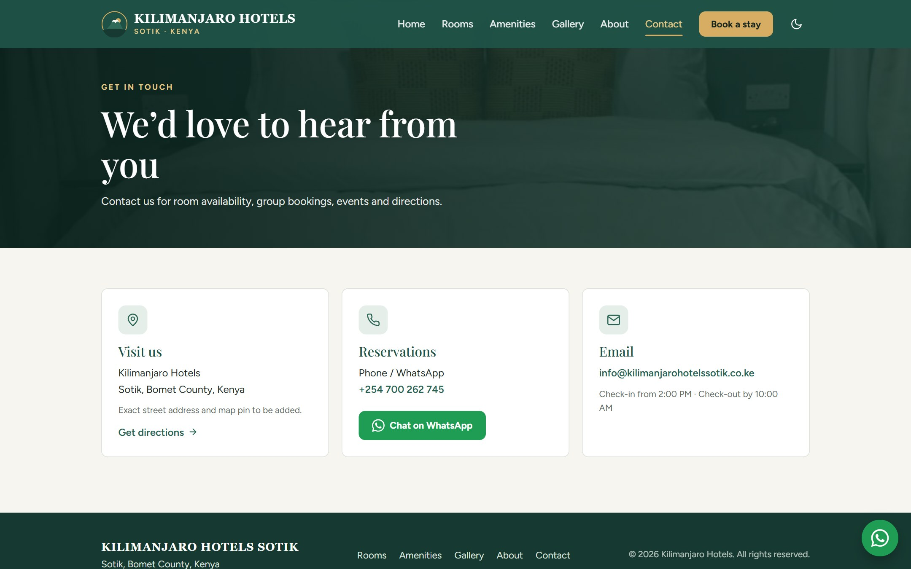

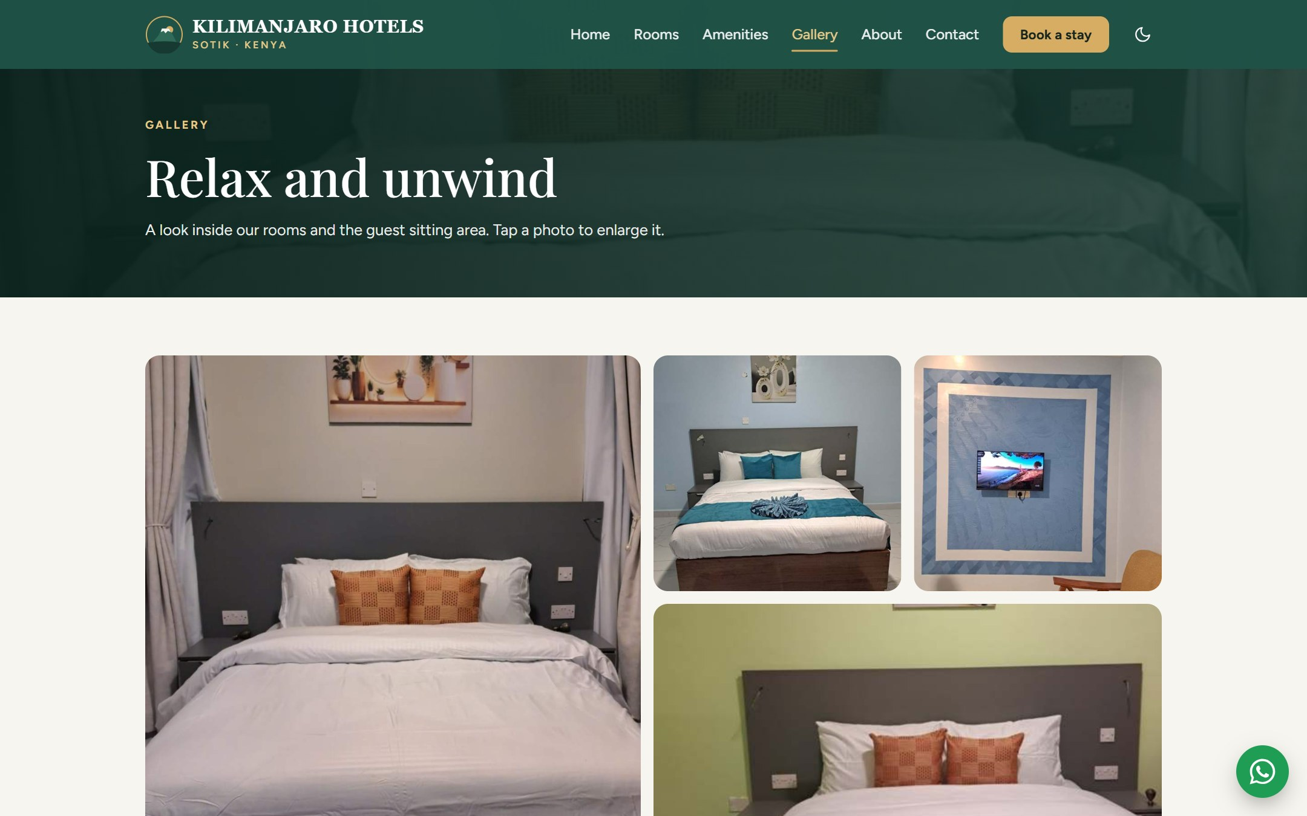

Answers before guests ask
Gallery
Real photos of every room. Tap to enlarge.
Amenities
Wi-Fi, restaurant, parking and more.
Contact and directions
Phone, WhatsApp, email and a map link.
Notes:
The gallery, amenities and contact pages answer the usual questions before a guest picks up the phone: what the rooms look like, what is included, and how to reach the hotel. Staff can change all of this from the admin panel.

Slide 15
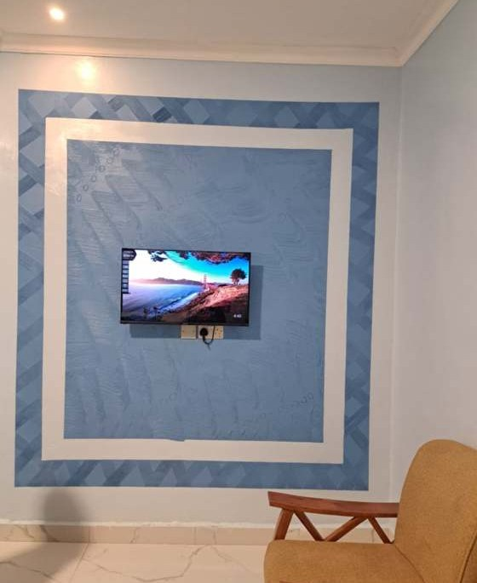
The admin panel
03
Where staff run the hotel day to day: bookings, rooms, prices and website content, in light or dark mode.
Notes:
Next, the admin panel. This is where staff work every day. These screenshots use made-up sample guests, not real bookings.

Slide 16
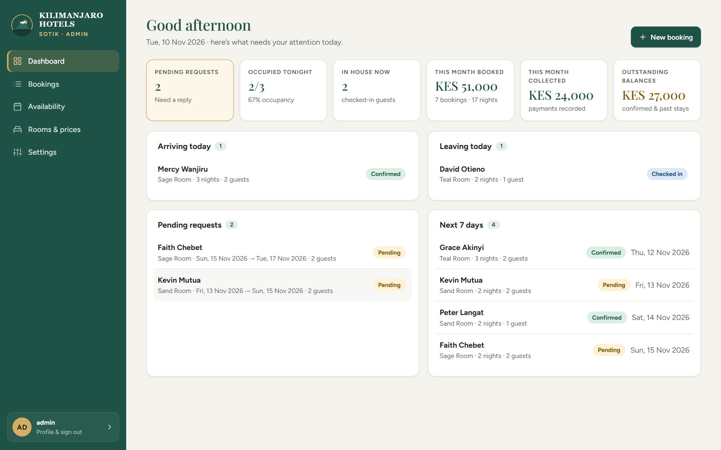



The dashboard: today at a glance
Requests waiting
New website requests, flagged until answered.
Arrivals and departures
Who's coming and going today.
Money at a glance
Booked, collected and still owed this month.
Notes:
After signing in, staff land on the dashboard, which greets them by the time of day in Kenya. It shows pending requests that need a reply, who arrives and leaves today, tonight's occupancy, and this month's booked revenue, money collected and balances still owed.

Slide 17
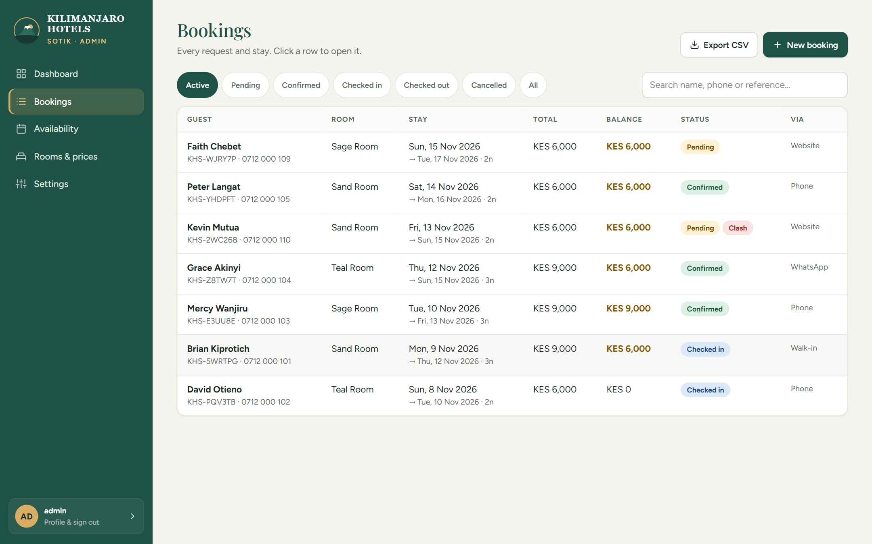



Every booking in one place
Filter and search
By status, name, phone or reference.
Clash badge
Flags a request that overlaps a confirmed stay.
Export to Excel
Download every booking as a CSV file.
Notes:
The Bookings page lists every booking with its room, dates, total, balance and where it came from: website, phone, walk-in or WhatsApp. Staff can filter by status or search by name, phone or reference. A red Clash badge warns when a request overlaps a confirmed stay. Export CSV downloads everything for Excel.

Slide 18
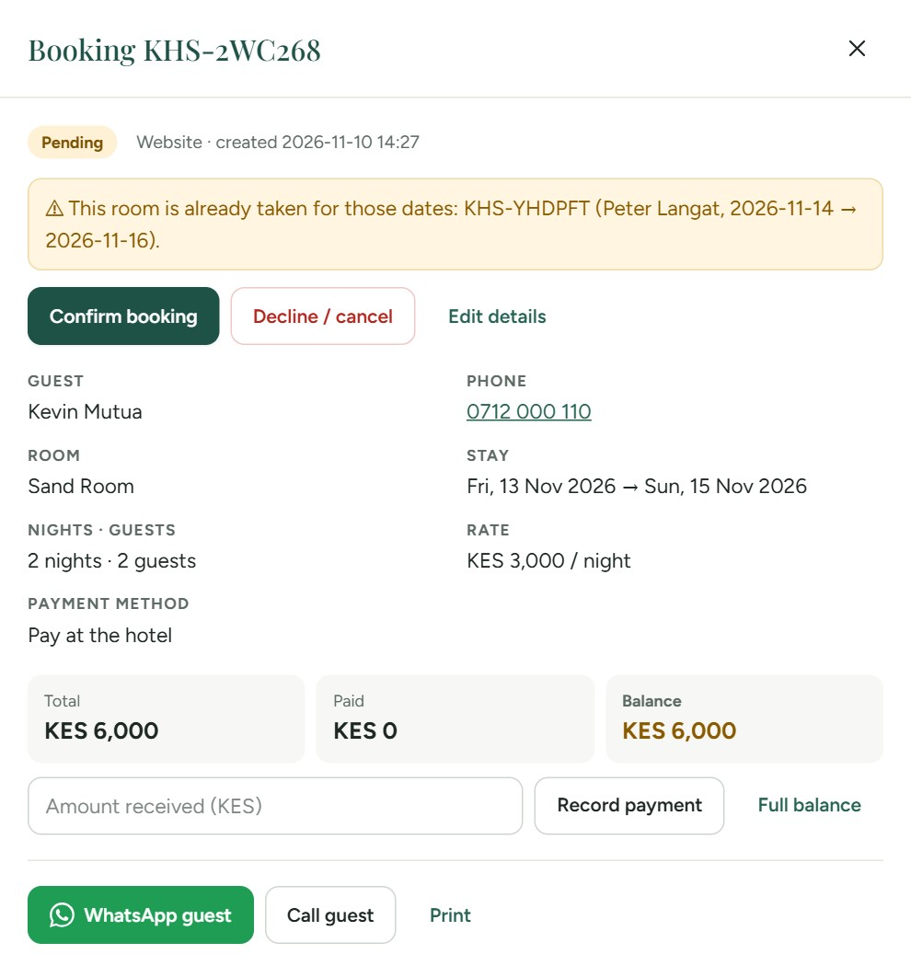
Confirm, take payment, reply
Confirm or decline
Confirmed dates close on the website.
No double bookings
An overlap is refused, and the reason is shown.
Record payments
Deposits and balances tracked per booking.
Contact the guest
WhatsApp, call or print in one tap.
Notes:
Opening a booking shows everything about it. One click confirms or declines it. Here the system warns that the Sand Room is already taken by another guest for those dates, so it cannot be double booked. Staff can record M-Pesa or cash payments and see the balance, and WhatsApp or call the guest directly.

Slide 19
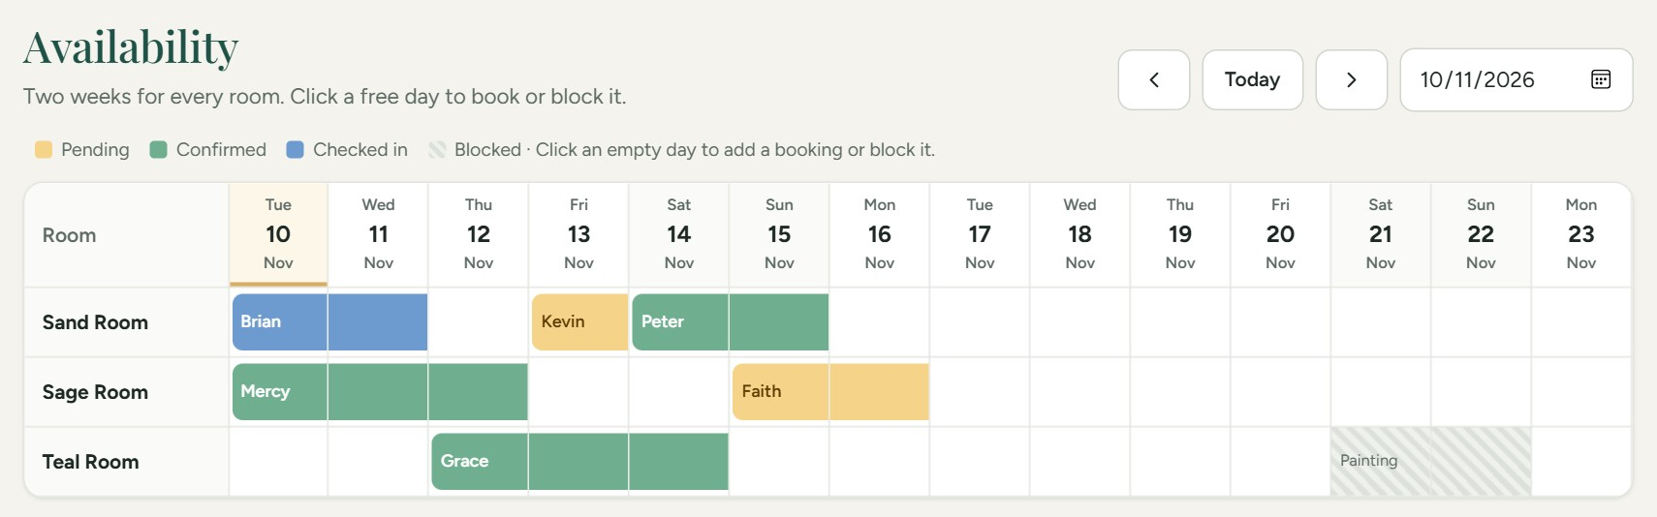



Availability calendar
Colour-coded
Click to book
Block dates
Pending, confirmed, checked in or blocked.
Click a free day to add a booking.
Close a room for painting or repairs.
Notes:
The Availability page shows two weeks for every room at once, coloured by status: yellow for pending, green for confirmed, blue for checked in, and stripes for blocked dates. Clicking a free day starts a booking or blocks the room, for example for painting.

Slide 20
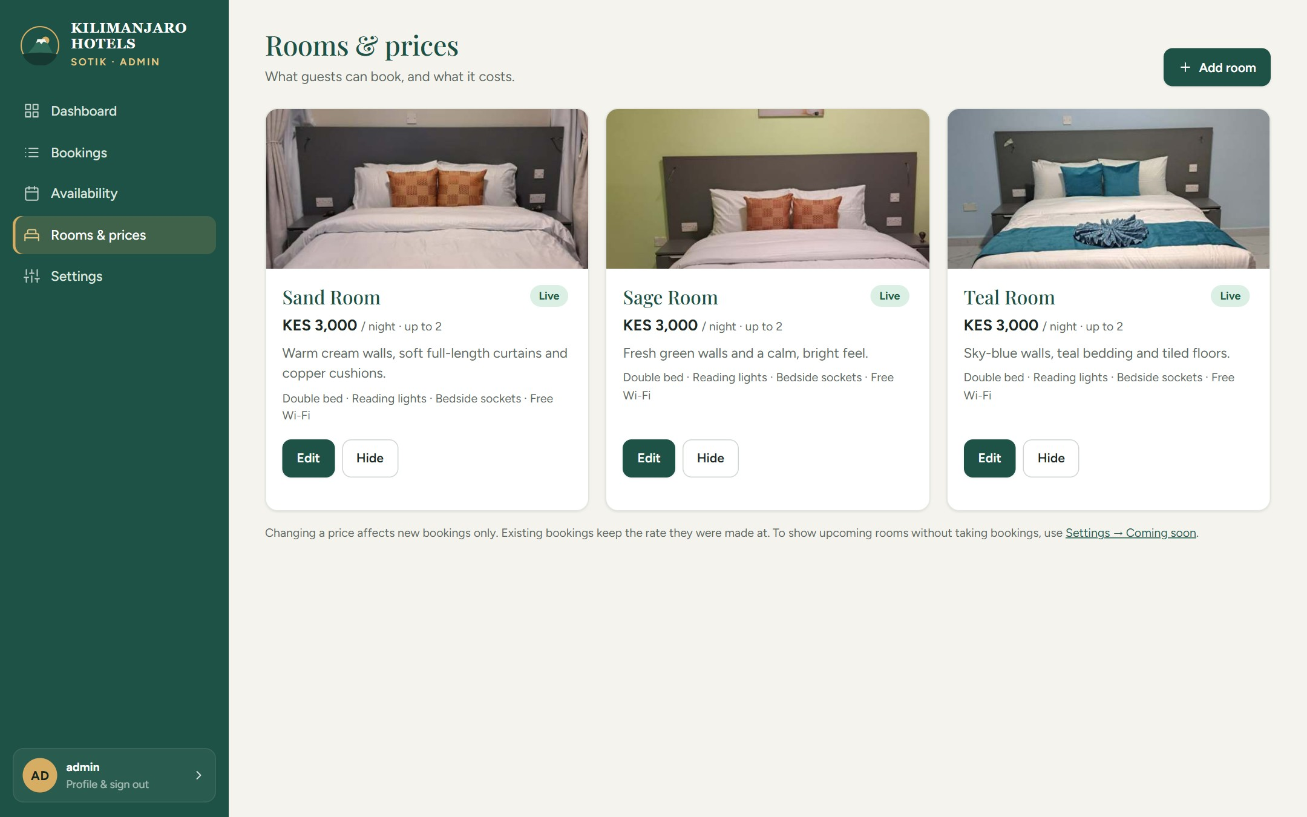
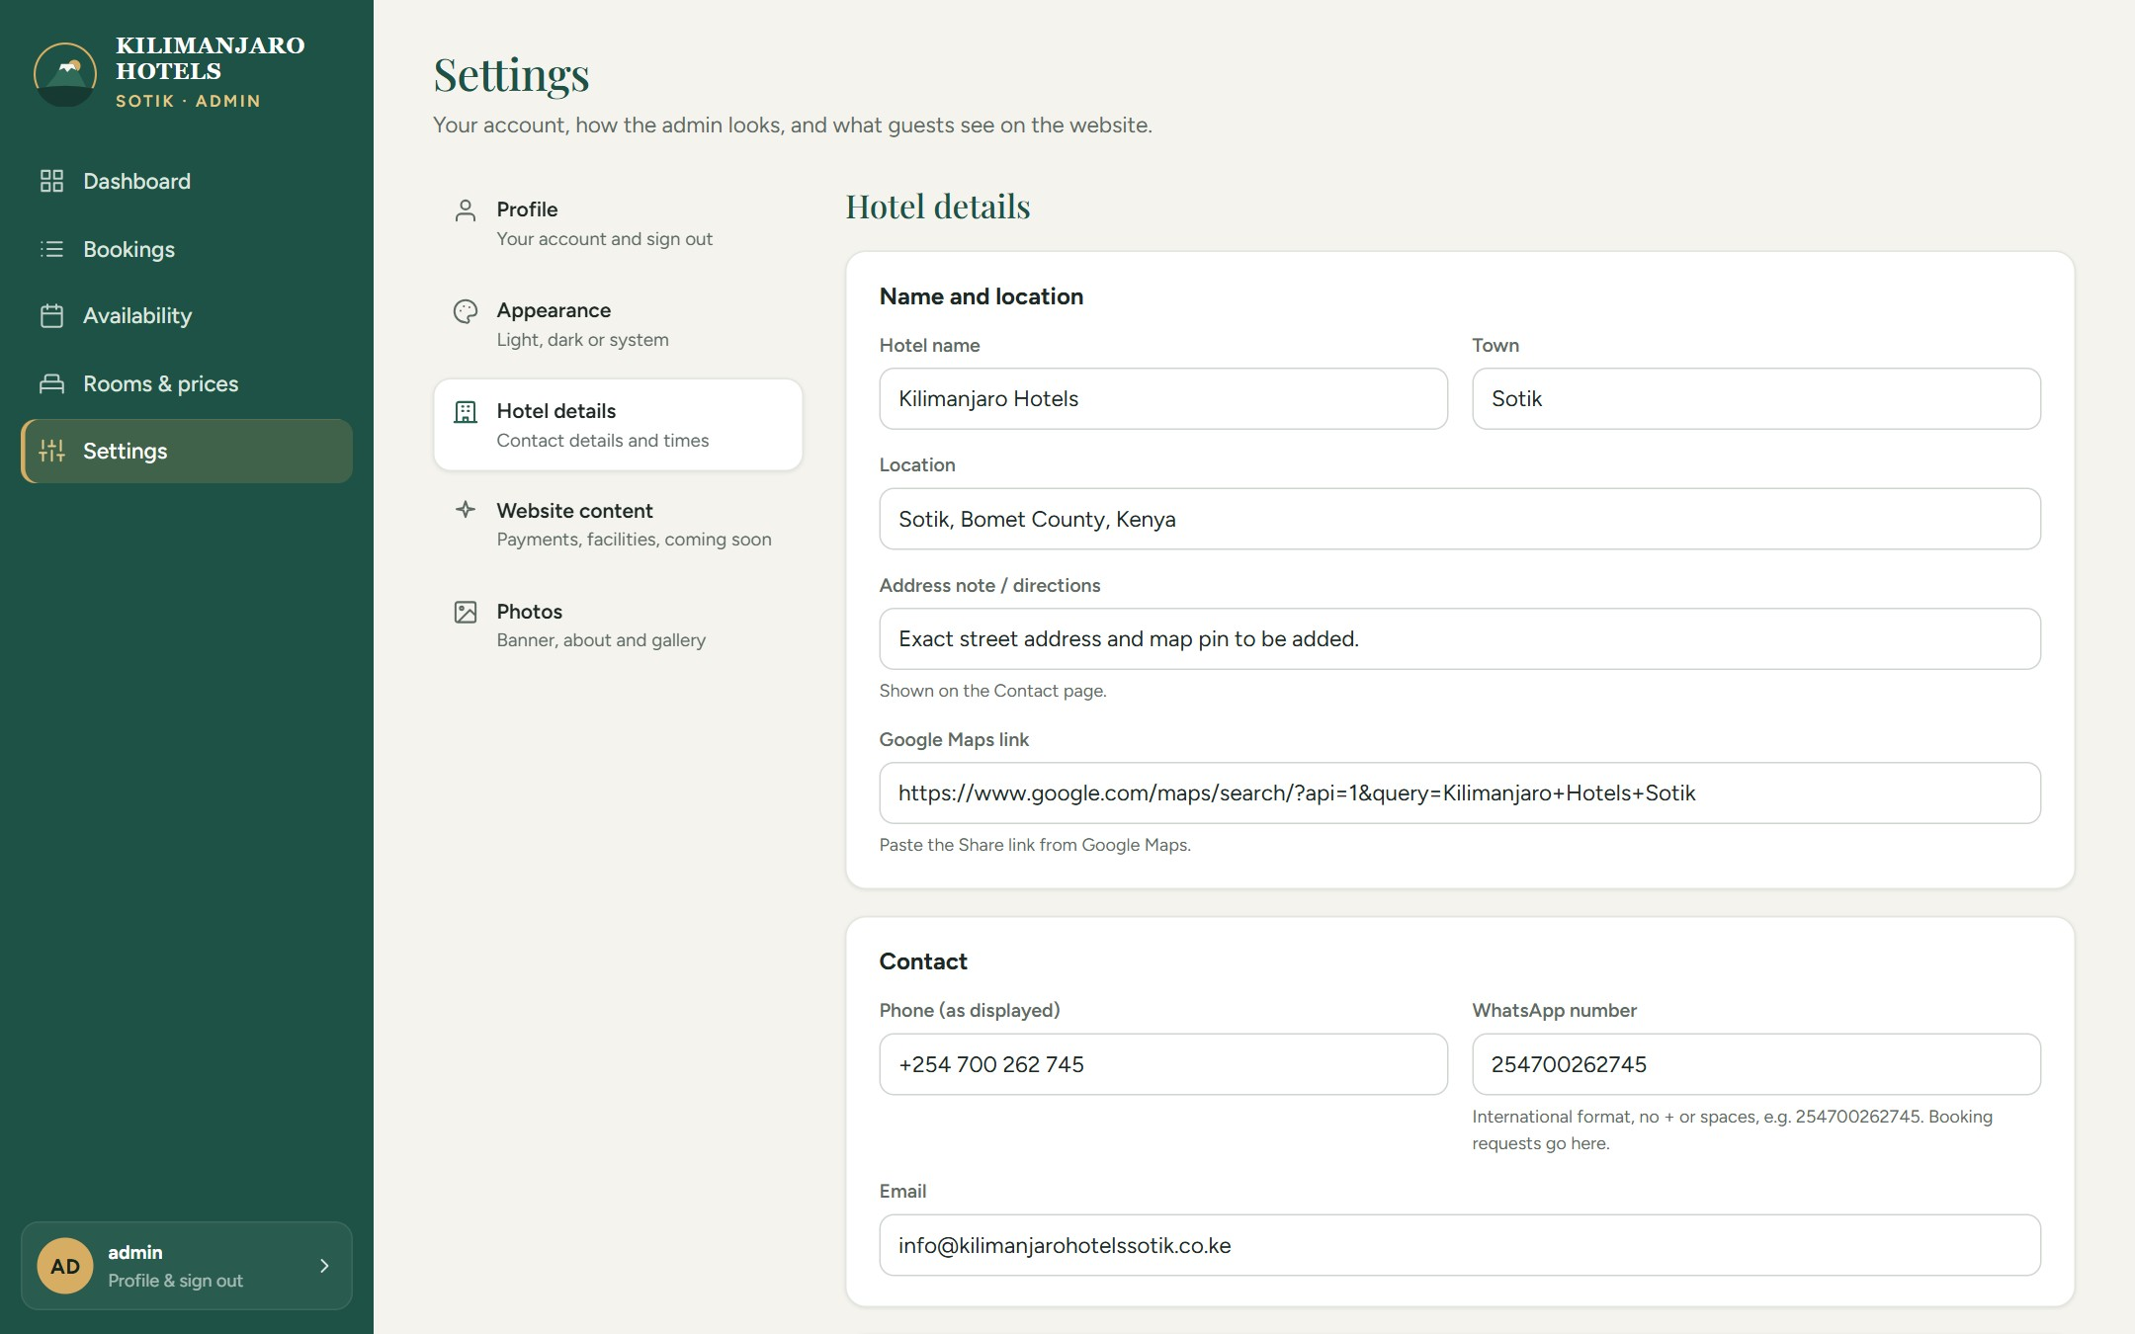
Rooms, prices and website content
Rooms & prices: add a room, change a price, upload photos or hide a room.
Settings: hotel details, website content and photos, each in its own tab.
Notes:
Staff can change the website without a developer. On Rooms and prices they add rooms, change prices, upload photos or hide a room. A price change applies to new bookings only. Settings is split into tabs: Hotel details for the phone, WhatsApp, address and check-in times; Website content for payment methods, facilities and the coming-soon box; and Photos for the banner and gallery. Unsaved changes show a save bar at the bottom, so nothing is lost by accident.

Slide 21
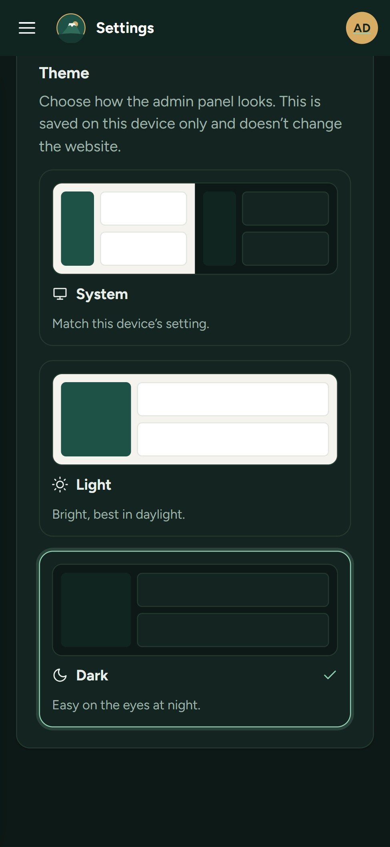

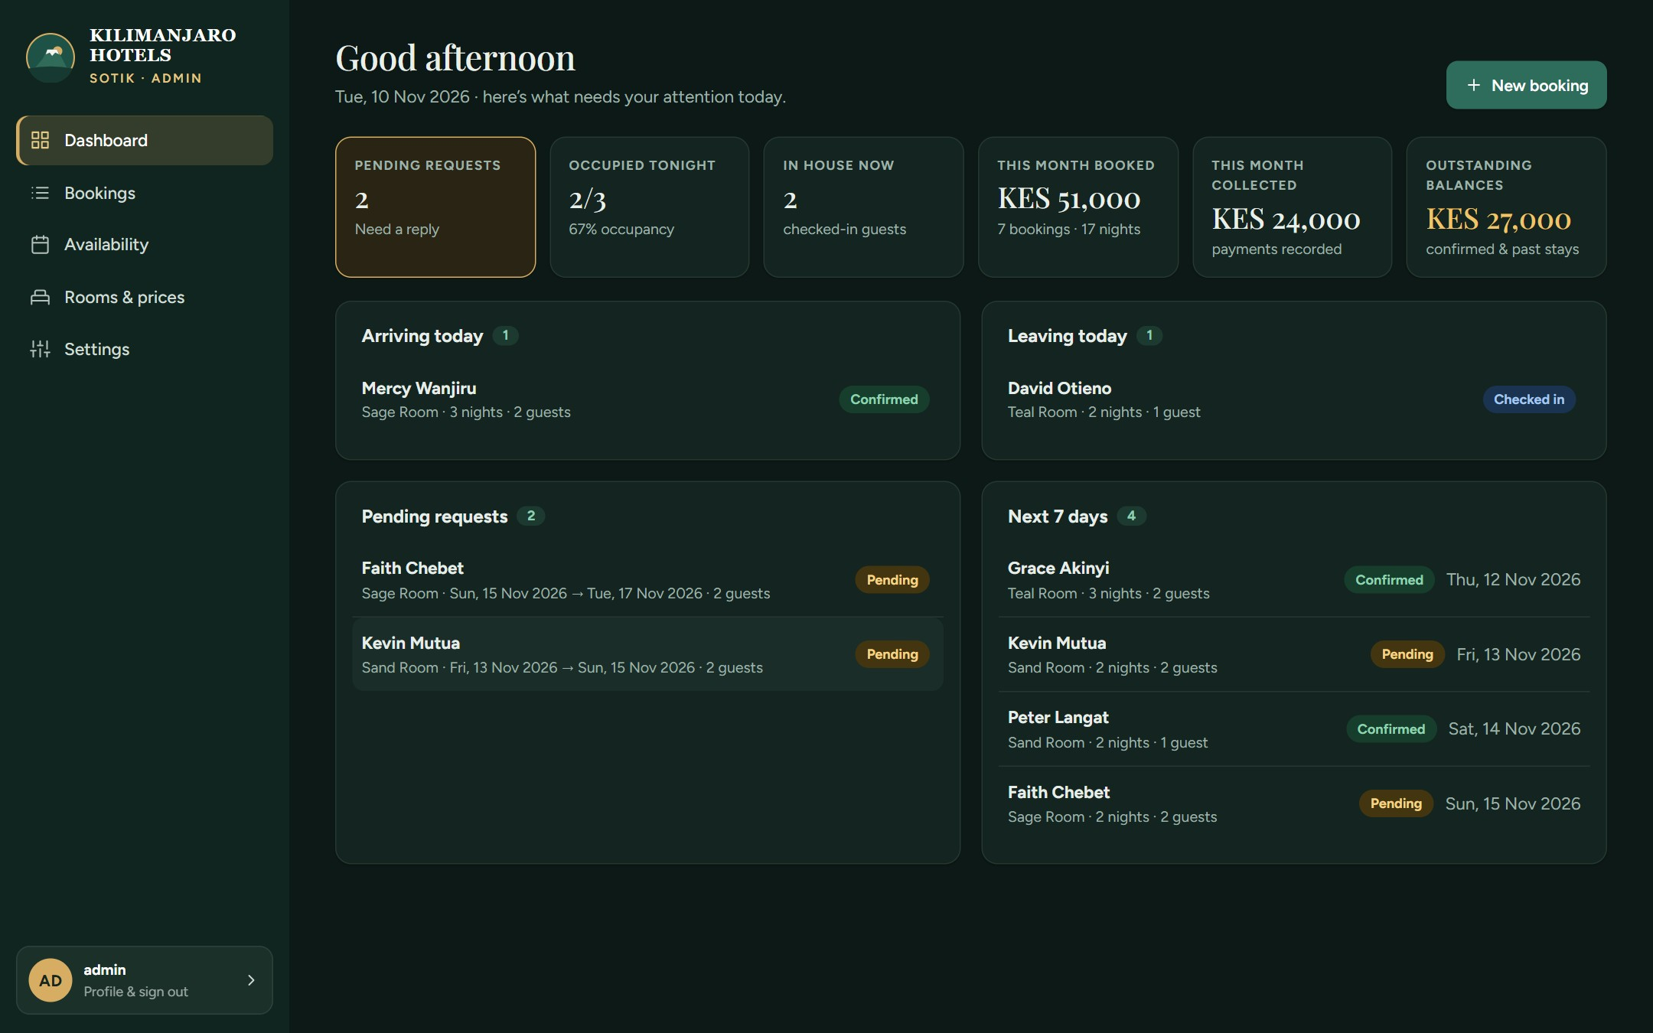
Profile, appearance and dark mode
Profile in one place
Who’s signed in, view the website, log out.
Light, dark or system
System follows the phone or computer.
Works on any screen
Each device remembers its own choice.
Notes:
Settings now opens on a Profile tab, which shows who is signed in, a link to view the website, the log-out button and password change. Under Appearance, each person picks Light, Dark or System; System follows the device and switches automatically at night. Here is the dashboard in dark mode, and the Appearance setting on a phone. The choice only changes the admin panel, never the public website.

Slide 22

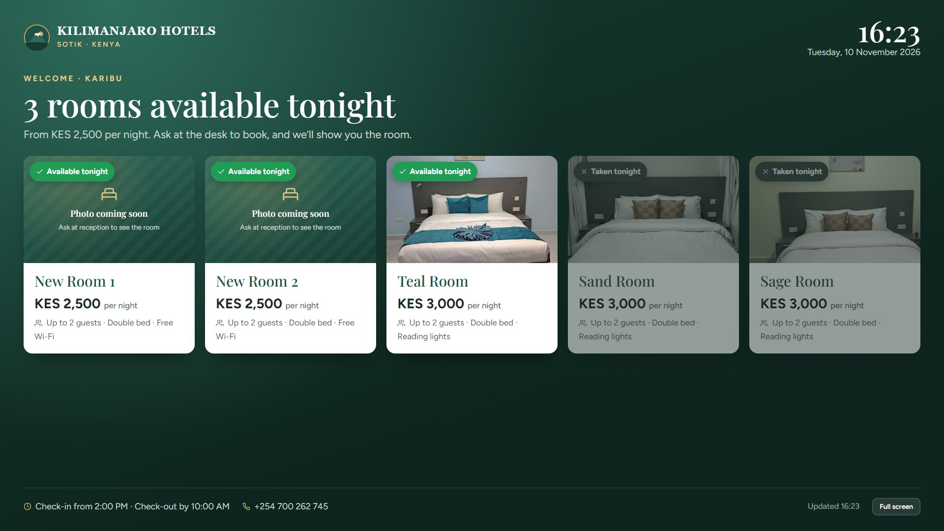


A reception screen for walk-ins
Rooms free tonight
On a TV or tablet at the front desk.
Updates by itself
Checks every minute, all day.
No guest details
Safe to face the lobby.
Notes:
For guests who walk in, the reception screen shows on a TV or tablet at the front desk which rooms are free tonight, with photos and prices. It updates itself every minute and never shows guest names. Rooms without photos yet, like the new 2,500-shilling rooms, show a photo-coming-soon card; the names New Room 1 and New Room 2 here are placeholders. Staff open it from the Availability page in the admin.

Slide 23

Behind the scenes
04
How a booking moves, where the system runs, and how guest data stays safe.
Notes:
Finally, a short look behind the scenes: how a booking moves through the system, where it runs and how it is protected.

Slide 24

How a booking moves
Request
Pending
Confirmed
Checked in
Checked out
From the website, phone, WhatsApp or a walk-in.
On the dashboard. The room is not held yet.
Dates close on the website. Overlaps refused.
Guest in the room. Payments recorded.
Stay complete. Counted in the month.
Why a request doesn’t hold the room
A fake or spam request can’t lock a room. Staff decide which requests to confirm.
Notes:
Every booking follows the same path. A request comes in as Pending and does not hold the room, so spam cannot block real guests. When staff confirm it, those dates close on the website and any overlapping booking is refused. Then the guest checks in and out, and payments are recorded along the way. Bookings can also be cancelled or marked as a no-show.

Slide 25



Free to run, private by design
Guest or staff
GitHub Pages
Supabase
Phone, tablet or computer
Website and admin panel
Bookings, photos and logins
KES 0
Staff-only sign-in
Guest details private
Only accounts you add can open the admin.
The public site can't read bookings.
a month to host, on the free GitHub Pages and Supabase plans.
No double bookings
Spam limit
The database refuses overlapping stays.
At most 3 requests per phone per hour.
Notes:
The website and admin panel are hosted on GitHub Pages, and the bookings, photos and staff logins are kept in Supabase. Both are on free plans, so hosting costs nothing today. Only staff accounts added by the hotel can open the admin panel. The public website can never read other guests' details. The database itself refuses double bookings and limits spam requests. Two things to know about the free plans: Supabase pauses a project after a week without activity, which the system prevents with a daily check-in, and it has no automatic backups, so bookings should be exported to CSV regularly.

Slide 26


Live and ready for bookings
Next steps
Website
1
Add the KES 2,500 rooms and their photos in Rooms & prices
hillarymutaik.github.io/
kilimanjaro-hotels-sotik
2
Put the reception screen on a TV or tablet at the desk
Admin panel
3
Add a login for each staff member
hillarymutaik.github.io/
kilimanjaro-hotels-sotik/admin
4
Add the street address and map pin in Settings
5
Export bookings to CSV every week (no automatic backups)
Notes:
The system is live today. The website and admin panel addresses are on the left. Five next steps: add the new 2,500-shilling rooms with their photos; put the reception screen on a TV or tablet at the front desk; give every staff member their own login; fill in the street address and map pin in Settings so the Contact page shows exact directions; export bookings to CSV every week, because the free Supabase plan has no automatic backups.

